Slide 1
Scheduler evolution in multi-core
Acknowledgement: Some slides taken from Aibester Niv.

Slide 2
Overview – focus
Review performance aspects when shifting to larger multicore processors
Review the potential improvements in Scheduling “understanding” when shifting to larger multicore processors
Focus of scheduling considerations and relationship to multicore performance.

Slide 3
Overview
“Your computer is already a distributed system. Why isn’t your OS? “
How multicore system behave and performs
How application behave and preforms on multicore system
Modern application
Multiple-threads of control-execution
Short simple arithmetic operations with heavy dynamic branching
Weak Cache locality.
Growing gap between CPU and memory – pipeline utilization is low ( 19% [6] )

Slide 4
evolving to multicore
Latency resulting from poor hit rates in the L1 cache can be effectively hidden by hardware multithreading [MT]
But high contention for the L2 can significantly hurt overall processor performance [2][4]
How can OS-Scheduling can improve this ?

Slide 5
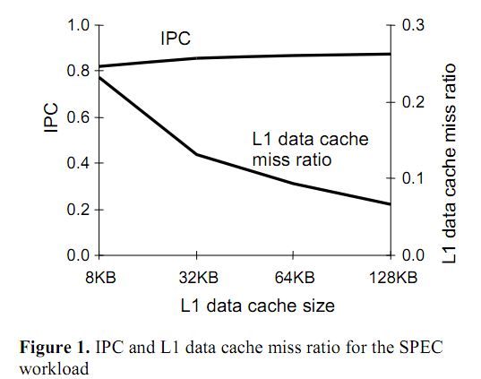
evolving to multicore
Multithreaded processor sensitivity to L1 cache miss ratio
[2] Performance of Multithreaded Chip Multiprocessors And Implications For Operating System Design. Alexandra Fedorova, Margo Seltzer , Christopher Small, Daniel Nussbaum. Harvard University, Sun Microsystems

Slide 6
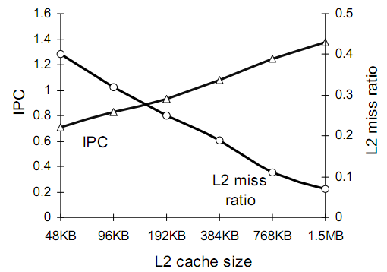
evolving to multicore
Multithreaded processor IPC and the L2 cache miss ratio for various L2 cache sizes
[2] Performance of Multithreaded Chip Multiprocessors And Implications For Operating System Design. Alexandra Fedorova, Margo Seltzer , Christopher Small, Daniel Nussbaum. Harvard University, Sun Microsystems

Slide 7
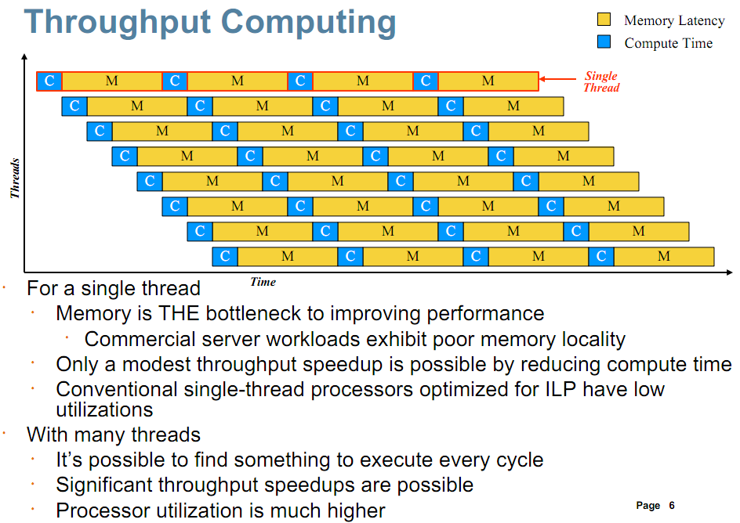
Example, Sun’s:Niagara2/UltraSPACR-T2
[3] Niagara2: A Highly Threaded Server-on-a-Chip . Robert Golla. Principal Architect Sun Microsystems, 2007 http://www.opensparc.net/pubs/preszo/06/04-Sun-Golla.pdf

Slide 8
evolving to multicore
Denning’s basic “Balance-set” scheduling
Separate all runnable threads into subsets, or groups – so that combined working set of each group fits in the cache
schedule a group at a time for the duration of the scheduling time slice
By making sure that the working set of each scheduled group fits in the cache, algorithm reduces cache miss ratios

Slide 9
evolving to multicore
Further studies [2] have shown that it is no the size of the working-set that needs to be “foreseen” when deciding where and when to schedule it
But the working-set’s memory locations reuse-pattern.
Estimate the miss-ration of each thread
Group together low-miss cache rate

Slide 10
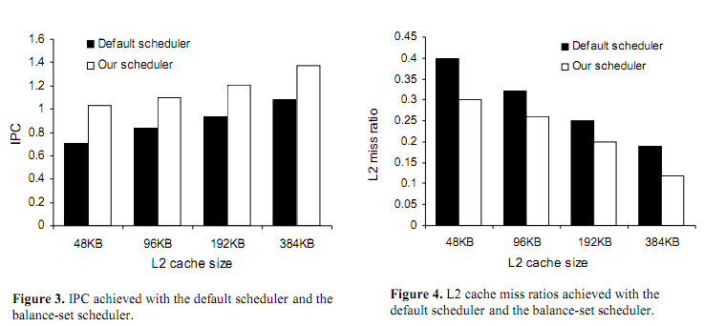
evolving to multicore processors Pattern-base Balance-set scheduling
[2] Performance of Multithreaded Chip Multiprocessors And Implications For Operating System Design. Alexandra Fedorova, Margo Seltzer , Christopher Small, Daniel Nussbaum. Harvard University, Sun Microsystems

Slide 11
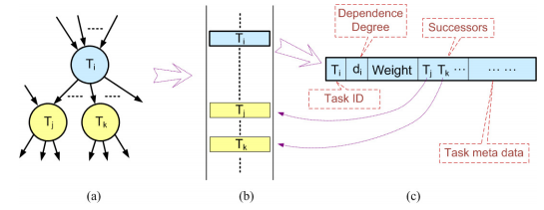
evolving to multicore processors
Multicore Hierarchical Scheduling with dynamic grouping
DAG structured tasks abstraction
Task scheduling for each DAG structure on multicore
Minimize the overall execution time by proper allocation of the tasks to concurrent threads ,
Preserving precedence constraints among the tasks

Slide 12
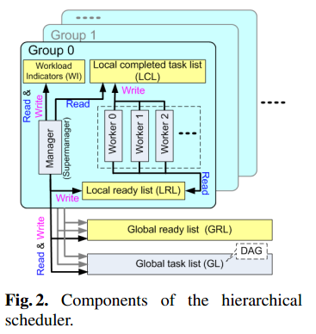
hierarchical scheduling with dynamic thread grouping
Components of the hierarchical scheduler
Rounded corners represent thread groups
Each group consists of a manager thread and several worker threads
Each group is bound to a core

Slide 13
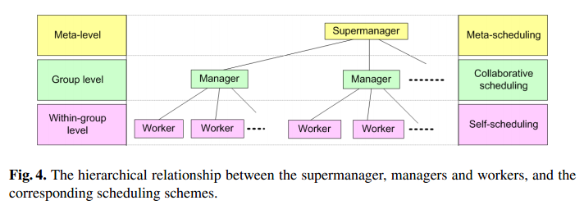
hierarchical scheduling with dynamic thread grouping
Supermanager - control group merging/partitioning.
Reconfiguring the schedulers according to the characteristics of the input task
Not scheduling tasks directly
Manager – bound to a core
Allocates tasks for the workers in the group
Collaborates with other groups for load-balancing.
Worker - in each group perform self-scheduling.

Slide 14
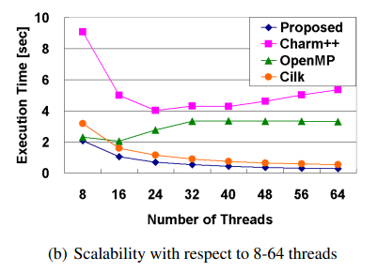
hierarchical scheduling with dynamic thread grouping
Performance evaluation example (Niagara2)
Task dependency graph of a random structure DAG with 10, 000 tasks
Average of 8 successors for each task
Each task was a dense operation - multiplication of two 30 × 30 matrices
Charm++ runtime system employs message passing based mechanism to migrate tasks for load balancing

Slide 15
evolving to multicore
Currently we have – “small-scale” CMP
Next step “large-scale” CMPs
Integrate 10s/100s of MT cores
Heterogeneous Cores
Application at multicore runtime needs are unknown
Limiting core recourses
“best placement” in respect to power/memory/capabilities

Slide 16
evolving to multicore processors Many-core-Run-Time : McRT
Create an Abstraction level framework
Study system behavior and performance
Includes mechanisms to enable scalability and employ different policies at runtime
Exposes a SW stack to be used by applications
Supports
Fine-grained parallelism
Large-scale CMP with Heterogeneous properties

Slide 17
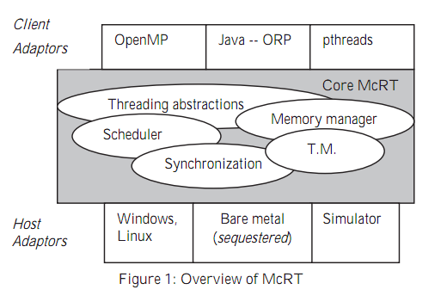
evolving to multicore processors Many-core-Run-Time : McRT
McRT – framework overview

Slide 18
evolving to multicore processors Many-core-Run-Time : McRT
McRT provides threading primitives
User-level threads
Futures threads , that are integrated into McRT schedule
McRT provides highly configurable, user-level scheduler that can be used to realize a variety of scheduling strategies
Scheduler framework exports an API to enable a client to dynamically configure the allocation of processing resources to tasks.
Task queue abstraction is also used for implementing scheduling domains

Slide 19
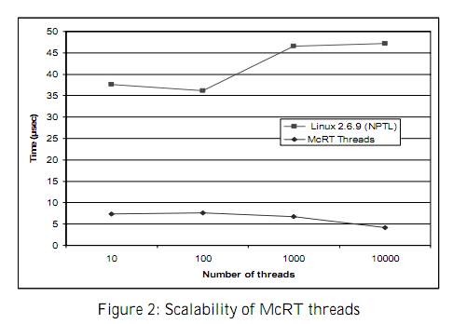
Resolve Second approach – McRT CMP SW-abstraction primitives

Slide 20
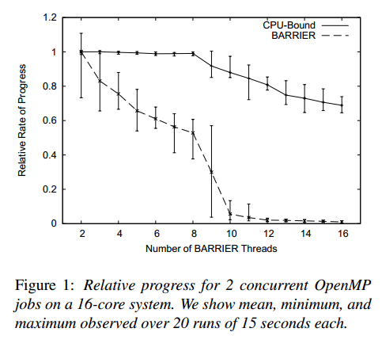
evolving to multicore processors Many-core-Run-Time : McRT
Runtime - no performance isolation
Performance isolation provides guaranteed resource allocation to an application so that it is not affected (or minimally affected) when it shares the internal system resources with other applications

Slide 21
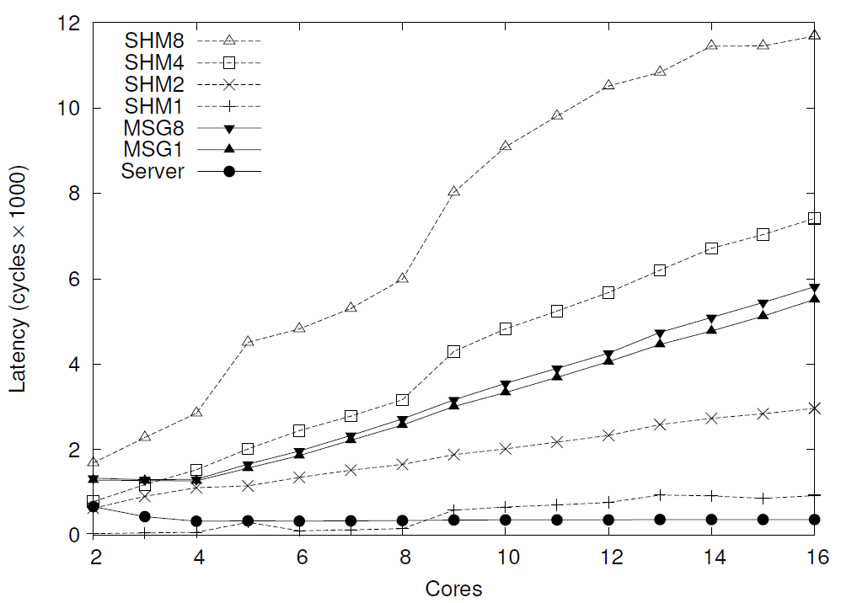
evolving to multicore
Messages vs. Shared Memory
Shared memory: threads pinned to each core directly update the same small set of memory locations.
Message passing: client threads issue a lightweight remote procedure call to a single server process that performs the update on their behalf.
The lack of scalability of the shared memory model will create increasingly intractable software engineering problems for OS kernels.
[8] The Multikernel: A new OS architecture for scalable multicore systems. systems Group, ETH Zurich, Microsoft Research, Cambridge. Andrew Baumann , Paul Barhamy, Pierre-Evariste Dagandz, Tim Harrisy, Rebecca Isaacsy, Simon Peter, Timothy Roscoe, Adrian Schüpbach, and Akhilesh Singhania

Slide 22
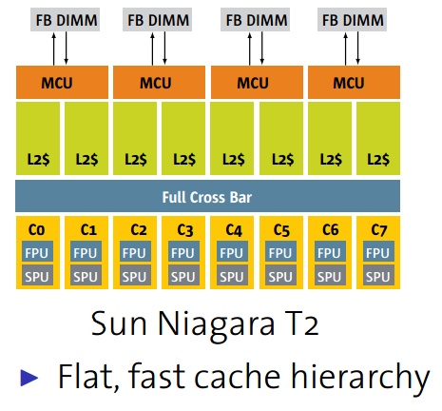
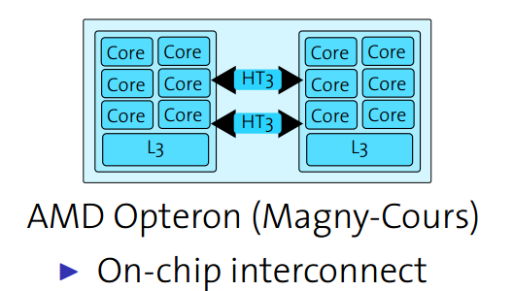
evolving to multicore
The Interconnection
Message-passing hardware has replaced the single shared interconnect for scalability reasons. Hardware thus resembles a message-passing network
System software needs to adapt to the inter-core topology, which in turn will differ between machines and become substantially more important for performance than at present

Slide 23
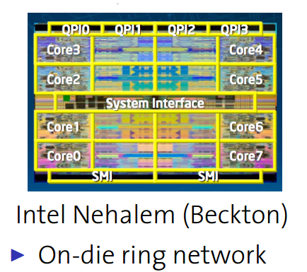
evolving to multicore
The Interconnection
Message-passing hardware has replaced the single shared interconnect for scalability reasons. Hardware thus resembles a message-passing network
System software needs to adapt to the inter-core topology, which in turn will differ between machines and become substantially more important for performance than at present

Slide 24
evolving to multicore - Performance isolation considerations
Contention over shared resources
provide memory QoS guarantees for each applications

Slide 25
evolving to multicore - Performance isolation considerations
Contention over shared cache

Slide 26
evolving to multicore - Performance isolation considerations
Contention over memory subsystem
Scheduling

Slide 27
Paradigm shift to “large-scale” multicore - Multikernel
Motivation
Need an end-to-end approach change
Hardware
Interconnectivity
Heterogeneous cores
OS-Scheduler
barrelshift
Runtime-system
McRT
Compliers
Programming abstractions
Applications

Slide 28
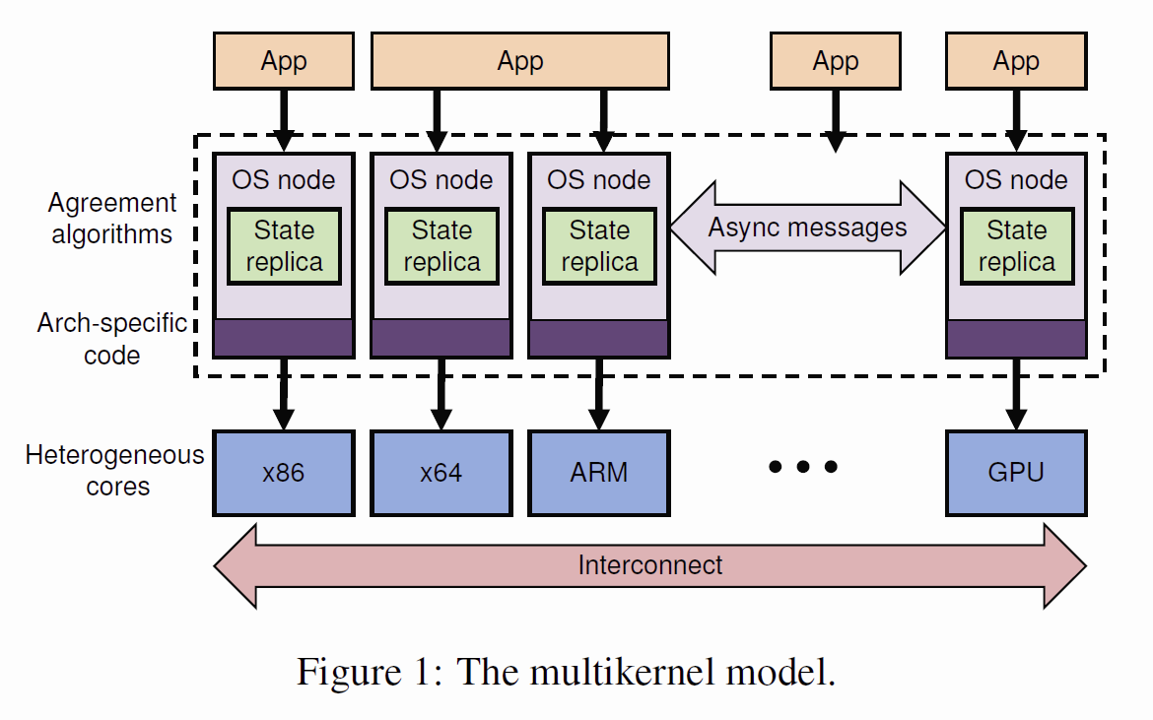
Paradigm shift to “large-scale” multicore - Multikernel
Structure the OS as a distributed system of cores
communicate using message passing and share no memory.
Three Design Principles:
All inter-core communication explicit
OS structure hardware-neutral
View state as replicated instead of shared

Slide 29
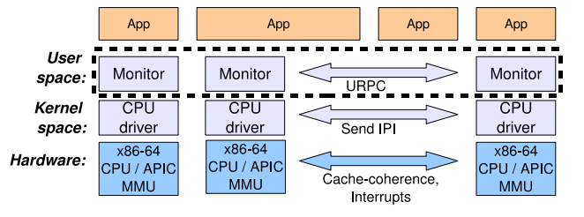
Paradigm shift to “large-scale” multicore – Multikernel model
Inter-core Communication
In a multikernel, all inter-core communication occurs with messages.
Different transport implementations for different hardware scenarios.
Explicit communication patterns facilitate reasoning about the use of the system interconnect.
Notes:
29

Slide 30
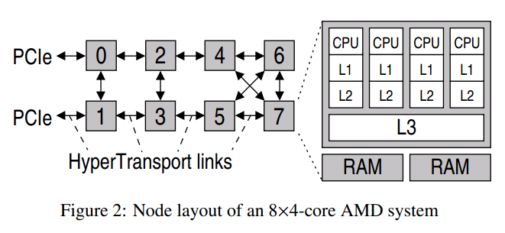
Paradigm shift to “large-scale” multicore – Multikernel model
Inter-core Communication
Explicit communication allows the multikernel to deploy well-known networking optimizations to make more efficient use of the interconnect.
The multikernel can provide isolation and resource management on heterogeneous cores.
Schedule jobs effectively on arbitrary inter-core topologies by placing tasks with reference to communication patterns and network effects.
Notes:
30

Slide 31
Paradigm shift to “large-scale” multicore – Multikernel model
Hardware-Neutral OS Structure
There are two aspects that are targeted at specific machine architectures, the messaging transport mechanisms, and the interface to hardware
Adapting the OS to run on hardware with new performance characteristics will not require extensive changes to the code base
Hardware-independence means that we can isolate the distributed communication algorithms from hardware implementation details.
Once the message transport is optimized, we can implement efficient message-based algorithms independently of the hardware details or memory layout.
Notes:
31

Slide 32
Paradigm shift to “large-scale” multicore – Multikernel model
System state as Replicated
Operating systems state must be accessible on multiple cores. In a multikernel, explicit communication between cores that share no memory leads to a model of global OS state replicated across cores.
A shared state is accessed and updated as if it were a local replica. The state is replicated as much as is useful, and consistency is maintained by exchanging messages.
Replicating data structures improve system scalability by reducing load on the system interconnect, contention for memory, and overhead for synchronization.
Notes:
32

Slide 33

Multikernal Barrelfish
Barrelfish is a multicore OS - built according to the multikernel model
Each operating system node
Runs on an execution unit and communicates with other operating system nodes via asynchronous messages
Maintains the replicated state of the system
Operating system's tasks are distributed between all the cores in the system (i.e. each core runs a different kernel)

Slide 34
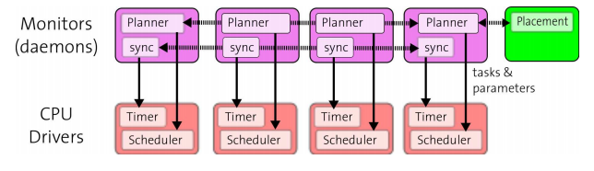
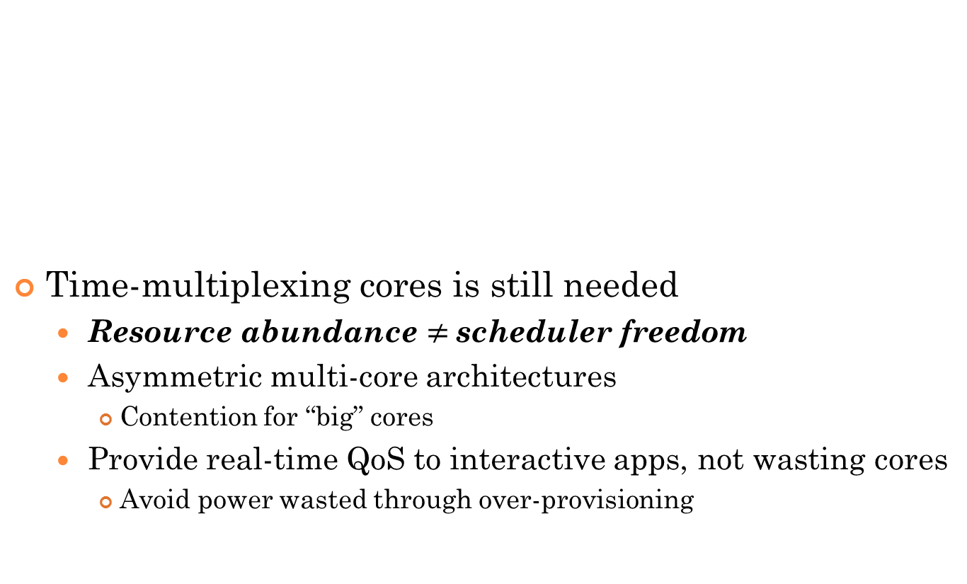
Multikernal Barrelfish scheduler structure
Time-multiplexing cores is still needed
Resource abundance $≠$scheduler freedom
Asymmetric multi-core architectures
Contention for “big” cores
Provide real-time QoS to interactive apps, not wasting cores
Avoid power wasted through over-provisioning

Slide 35
Multikernal Barrelfish scheduler structure
Schedule at multiple timescales
Preform Interactive-workloads in parallel
Requirements might change abruptly (Eg. parallel web browser)
Interactive time scales
Small overhead when scheduling
Synchronized scheduling on every time-slice won’t scale

Slide 36
Multikernal Barrelfish scheduler structure
Combination of techniques at different time granularities
Long-term placement of apps on cores
Medium-term resource allocation
Short-term per-core scheduling

Slide 37
Multikernal Barrelfish scheduler structure
Phase-locked Gang-scheduling approach
Groups of related threads scheduled as a unit (a gang)
All members of a gang runs simultaneously on different cores on the same time-slice
All gang members start and end time slices together

Slide 38
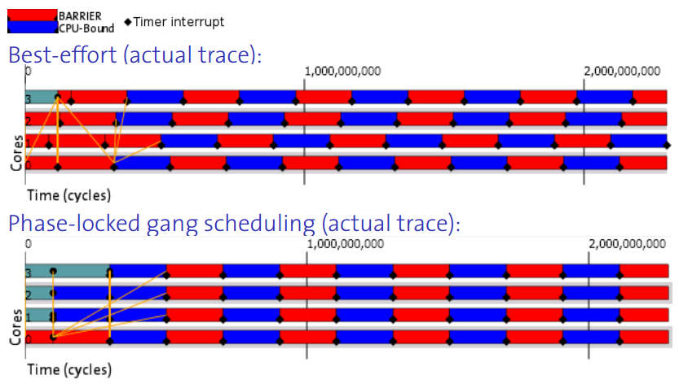
Multikernal Barrelfish scheduler structure
Phase-locked Gang-scheduling approach

Slide 39
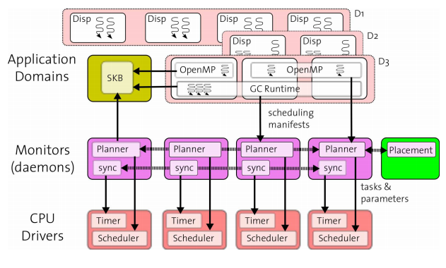
Multikernal Barrelfish scheduler structure
“Higher” level Reasoning
about the hardware
online about each application
Applications and OS must communicate (McRT)

Slide 40
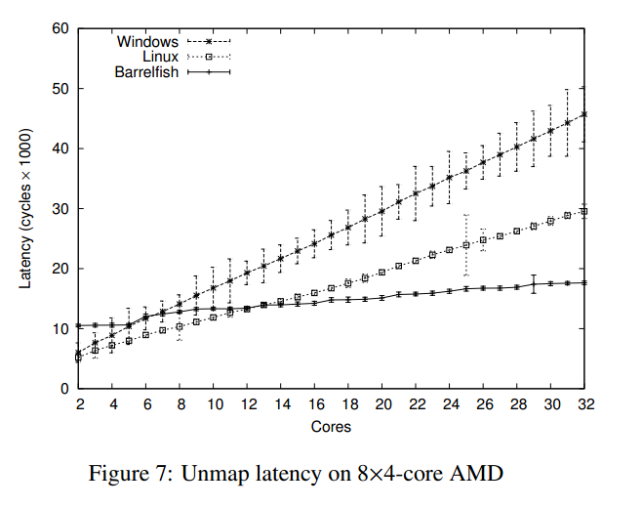
Multikernal Barrelfish evaluation
message-based unmap operation in Barrelfish Vs. the equivalent IPI-based mechanisms in Linux 2.6.26 and Windows Server 2008 R2 Beta, Enterprise Edition.

Slide 41
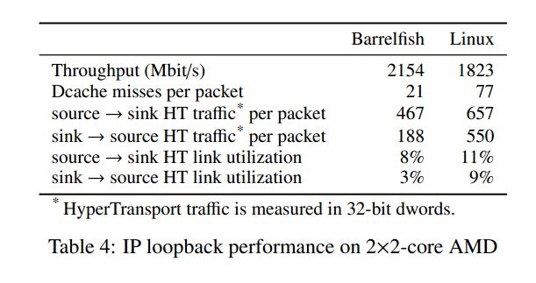
Multikernal Barrelfish evaluation
point-to-point link : connecting two user-space IP stacks via URPC.
By executing a packet generator on one core and a sink on a different core

Slide 42
[1] An Analysis of Database Workload Performance on Simultaneous Multithreaded Processors. ISCA, June 1998. J. Lo et al.
[2] Performance of Multithreaded Chip Multiprocessors And Implications For Operating System Design. Alexandra Fedorova, Margo Seltzer , Christopher Small, Daniel Nussbaum. Harvard University, Sun Microsystems
[3] Niagara2: A Highly Threaded Server-on-a-Chip . Robert Golla
Principal Architect Sun Microsystems, 2007 http://www.opensparc.net/pubs/preszo/06/04-Sun-Golla.pdf
[4] Throughput-Oriented Scheduling On Chip Multithreading Systems. A. Fedorova, M. Seltzer, C. Small and D. Nussbaum. Technical Report TR-17-04, Harvard University, August 2004.
[5] Thrashing: Its causes and prevention. P. Denning. Proc. AFIPS 1968 Fall Joint Computer Conference, 33, pp. 915-922, 1968
[6] Levy, Simultaneous Multithreading: Maximizing On-Chip Parallelism. D. Tullsen, S. Eggers, H. ISCA, June 1995
[7] Enabling Scalability and Performance in a Large Scale CMP Environment. Programming Systems Lab, Digital Enterprise Group Intel Corporation
[8] The Multikernel: A new OS architecture for scalable multicore systems. systems Group, ETH Zurich, Microsoft Research, Cambridge. Andrew Baumann , Paul Barhamy, Pierre-Evariste Dagandz, Tim Harrisy, Rebecca Isaacsy, Simon Peter, Timothy Roscoe, Adrian Schüpbach, and Akhilesh Singhania

Slide 43
Time-multiplexing cores is still needed
Resource abundance != scheduler freedom
Asymmetric multi-core architectures
Contention for “big” cores
Provide real-time QoS to interactive apps, not wasting cores
Avoid power wasted through over-provisioning

Slide 44
Distributed “everything” Cache, memory management, connectivity
Big centralized caches don’t scale
Contention
Long latency
High power
Distributed caches have numerous benefits
Lower power (less logic lit-up per access)
Exploit locality (local L1 & L2)
Can exploit various cache placement mechanisms to enhance performance
Distributed caches
Completely
HW Coherent
Cache
System
Global 64-bit address space

Slide 45
This illustrates the pitfalls of scheduling a mix of workloads on multicore systems, a problem which
to date has not been well studied in the literature.
Smart runtimes such as McRT [23] cannot solve this problem, since it is one of lack of coordination between runtimes.

Slide 46
evolving to multicore
Cache Coherence
As the number of cores and the subsequent complexity of the interconnect grows, hardware cache-coherence protocols will become increasingly expensive.
OS will have to handle non-coherent memory or will be able to realize substantial performance gains by bypassing the cache-coherence protocol.

Slide 47
evolving to multicore processors Many-core-Run-Time : McRT
C workloads have generally
enjoyed exclusive use of hardware, or a static partition thereof. However, in a general-purpose system multiple simultaneous parallel programs can interfere signiﬁcantly.
When there are fewer total threads than cores, BARRIER’s progress depends both on the number of threads and how the OS places them on cores: a barrier between threads on the same package costs about half as much as one between different packages. This accounts for the high performance variance for BARRIER with low thread counts, even though enough cores are available to schedule all threads simultaneously. When the applications contend for cores their performance degrades unequally: the CPU-bound process slows down linearly, but BARRIER’s progress rate collapses since preemption of any thread can cause synchronization to take an order of magnitude longe

Slide 48
Overview – focus
Evolution to multicore processors
Problems when evolving to multicore processors
Paradigm shift to “large-scale” multicore
Motivation
McRT – Adaptive scheduling
Multikernel – barrelfush scheduling

